Slide 1

Work related learning
Week 5 organisational structure and functions

Slide 2
Learning outcomes
At the end of this session, students will be able to ;
1-Describe the Basic structure of An organisation.
2-Explain the functions Of An Organisation.

Slide 3
LO1 Activity -15 mins
Class Discussion
What is An Organisation ?

Slide 4
the purpose and importance of structure
The purpose of structure is the division of work among members of the organisation and the co-ordination of their activities so they are directed towards the goals and objectives of the organisation. Structure makes possible the application of the process of management and creates a framework of order and command through which the activities of the organisation can be planned, organised, directed and controlled. The structure defines tasks and responsibilities, work roles and relationships, and channels of communication.
Underlying the effective management of people is the requirement for a clear understanding of the nature of the business in which the organisation is engaged. If the organisation is to be successful then its structure must be related to its objectives and to its strategy. Structure must be designed to be appropriate to environmental influences, the continued development of the business and the management of opportunities and risks (Mullins, 2016. p,395)

Slide 5
Conti…
Underlying the effective management of people is the requirement for a clear understanding of the nature of the business in which the organisation is engaged. If the organisation is to be successful then its structure must be related to its objectives and to its strategy. Structure must be designed to be appropriate to environmental influences, the continued development of the business and the management of opportunities and risks.
Good organisation structure does not by itself produce good performance. But a poor organisation structure makes good performance impossible, no matter how good the individual managers may be. To improve organisation structure . . . will therefore always improve performance.

Slide 6
Conti…
Structure provides the framework for the activities of the organisation and must harmonise with its goals and objectives. The purpose of structure may be summarised as to provide for:
economic and efficient performance of the organisation and level of resource utilisation;
monitoring activities of the organisation;
accountability for areas of work undertaken by groups and individual members of the organisation;
co-ordination of different parts of the organisation and different areas of work;
flexibility in order to respond to future demands and developments, and to adapt to changing environmental influences; and
social satisfaction of members working in the organisation.

Slide 7
Critical Review and Reflection
Personalities are an important part of the work organisation. Whatever its formal structure, in practice the actual operations of the organisation and success in meeting its objectives will depend upon the behaviour and actions of people within the structure.
To what extent do YOU think people give shape and personality to the formal structure of YOUR selected Health and Social Care organisation?

Slide 8
working together and major function
Within the formal structure, work has to be divided among its members and different jobs related to each other. The division of work and the grouping together of people should, wherever possible, be organised by reference to some common characteristic that forms a logical link between the activities involved. Work can be divided, and activities linked together, in a variety of ways.
The most common basis for grouping activities is according to specialisation, the use of the same set of resources, or the shared expertise of members of staff. It is a matter for decision in each organisation as to which activities are important enough to be organised into separate functions, departments or sections.

Slide 9

LO2 Activity – Individual Research -15mins.
Identify the functions Of a Health and social care Organisation

Slide 10
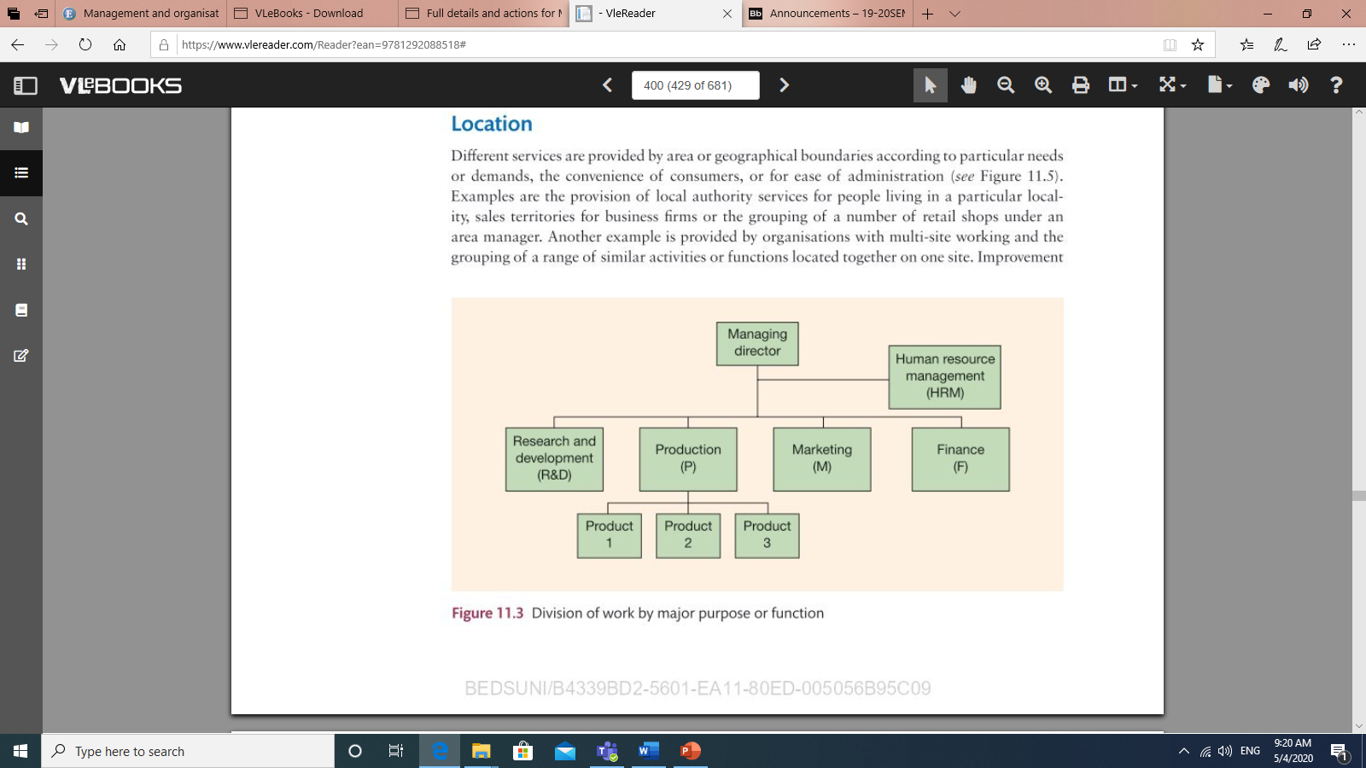
Division of work for major purpose or function

Slide 11
task and element functions
In order to produce some product, or provide some service, there are four essential functions that the organisation must perform:
The product or service must be developed.
Something of value must be created – the production or manufacture of a product or provision of a service.
The product or services must be marketed, and distributed or made available to those who are to use them.
Finance is needed in order to make available resources for the development, creation and distribution of the products or services provided.

Slide 12
Reflection
Determine your career pathway into the selected organisation?
Which function in an organisation you are interested with?
Have a reflection on your skills and abilities to achieve this goal
How you would meet the person specification of the selected career pathway into the selected organisation.

Slide 13
Reference:
Mullins, Laurie J (2016) Management and organisational behavior. 11th ed. Pearson Education. pp, 395-400

